Slide 1
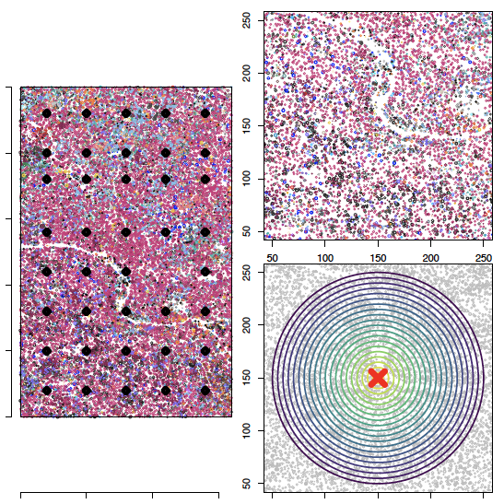
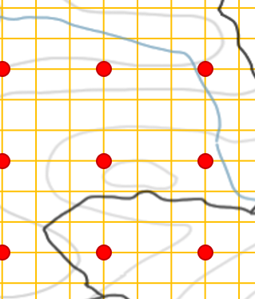
Subsample points
Incubation
experiment
Dilution
experiment
eDNA
community
Homogenized samples
ice
dry
Diluted
Comparison of:
OTU richness
Composition
Confusion matrix
ambient
Undiluted
tree
Community

Slide 2
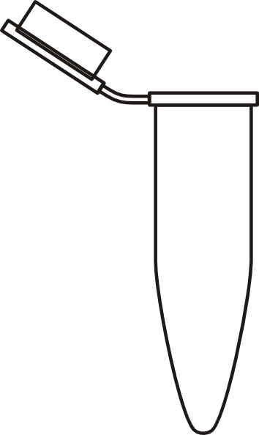
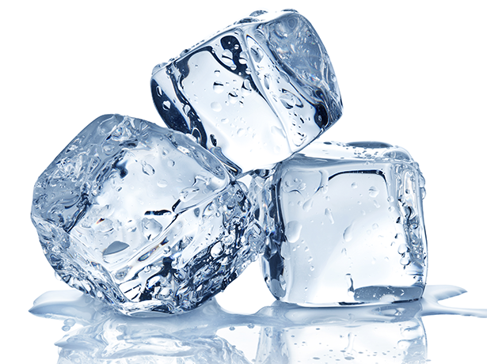
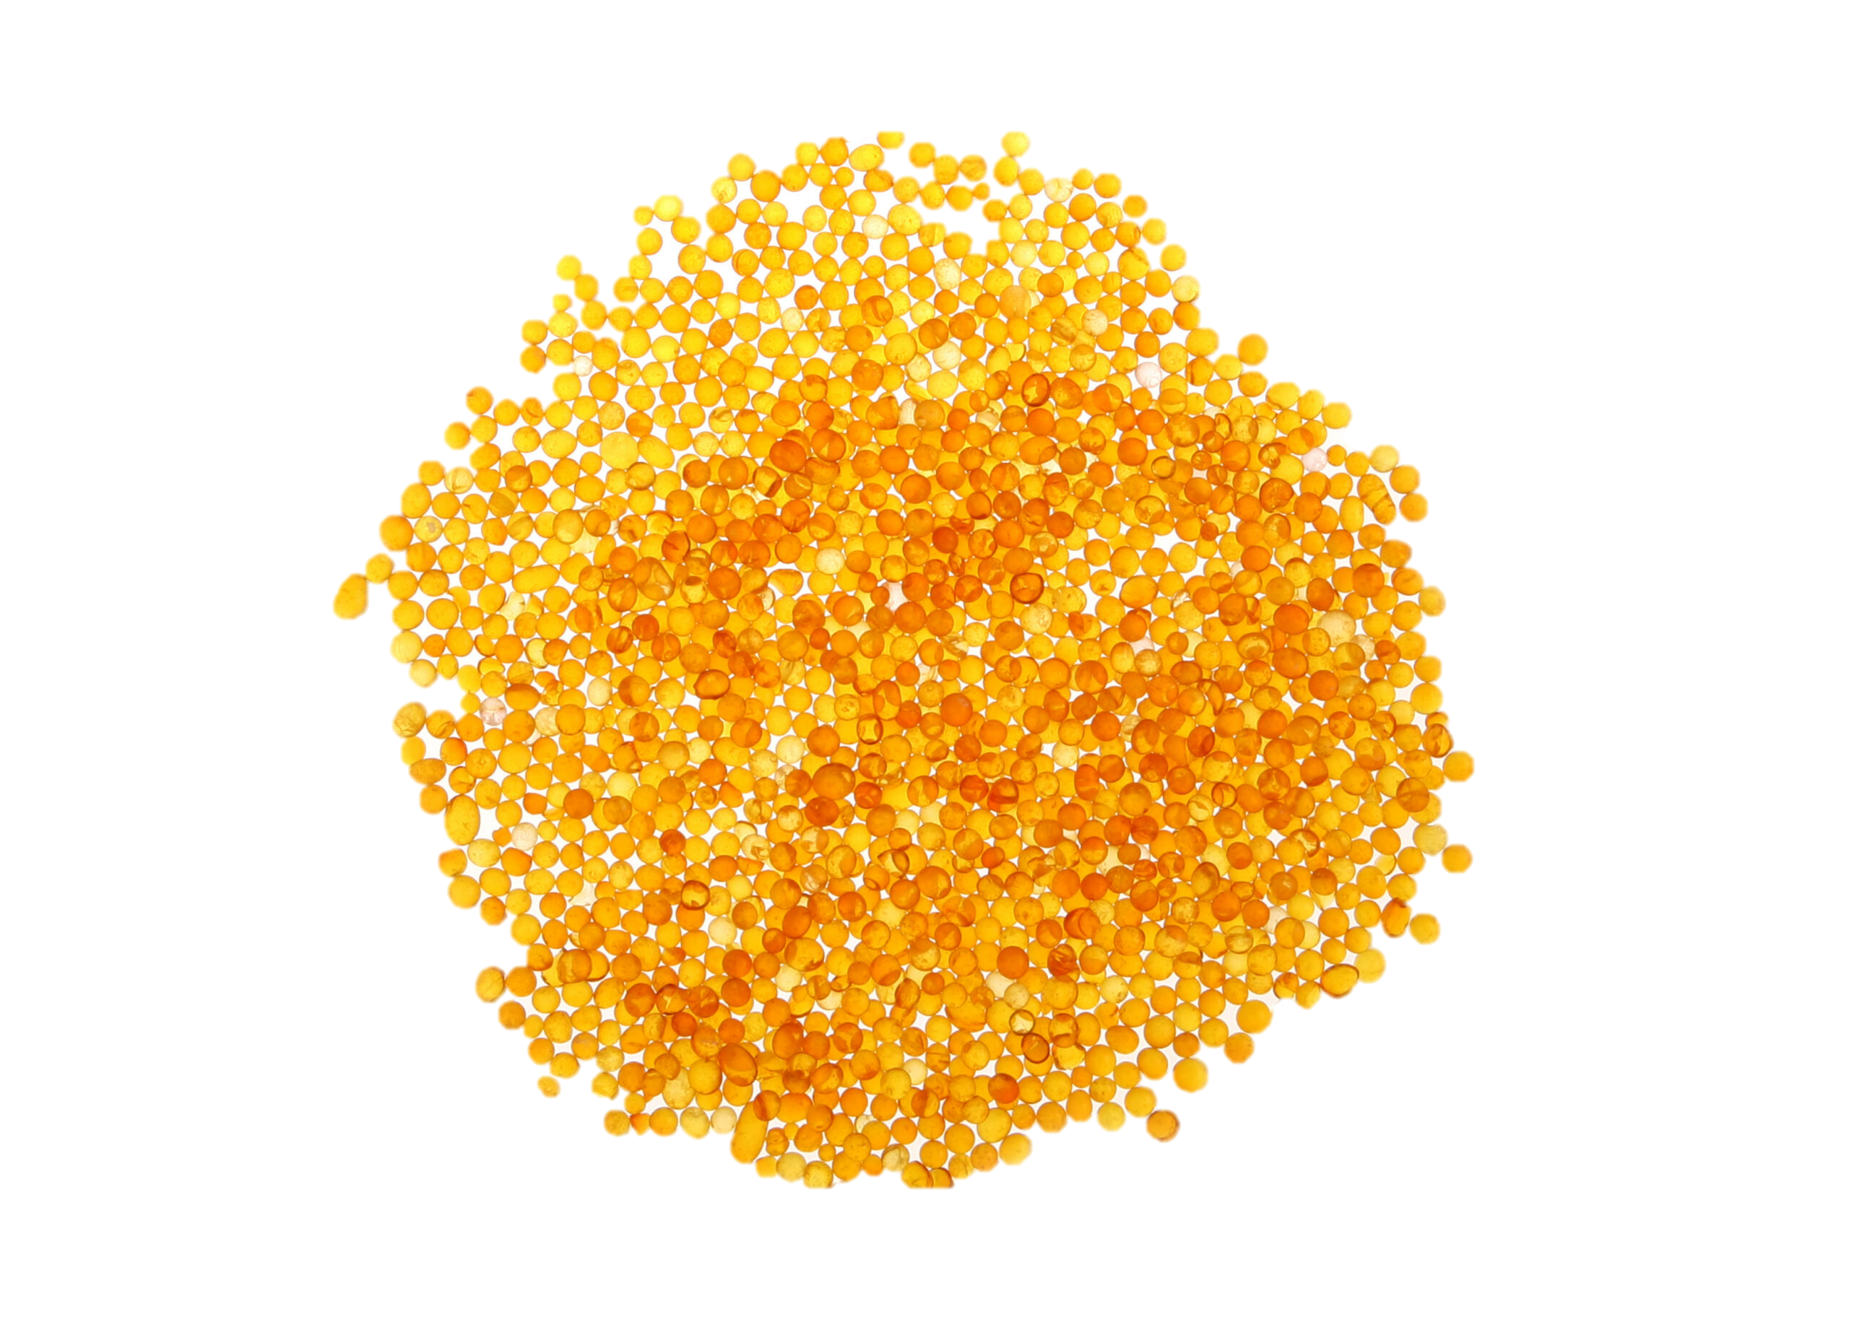



A) LFDP Field Sampling
B) Homogenization
C) Incubation experiment
D) Dilution experiment
E) eDNA community
$$\text{×}$$
2m
Ambient
Purified
$$\text{×}$$
Ice
Dry
Diluted
Sample location
Subsample locations
H) Data analysis
F) Tree neighborhoods
OTU richness
Composition
Confusion matrix
G) Tree community
$$\text{×}$$

Slide 3
A) LFDP Field Sampling
B) eDNA community
D) Data analyses
OTU richness
OTU composition
Confusion matrix
C) Tree community
(with different radii)

